Slide 1
Java IO

Slide 2
package java.io contains
Classes for reading input from a stream of data.
Classes for writing output to a stream of data.
Classes that manipulate files on the local filesystem.
Classes that handle object serialization

Slide 3
Streams
Byte Streams - handle I/O of raw binary data.
Character Streams - handle I/O of character data, automatically handling translation to and from the local character set.
Buffered Streams - optimize input and output by reducing the number of calls to the native API.
Data Streams - handle binary I/O of primitive data type and String values.
Object Streams - handle binary I/O of objects.

Slide 4
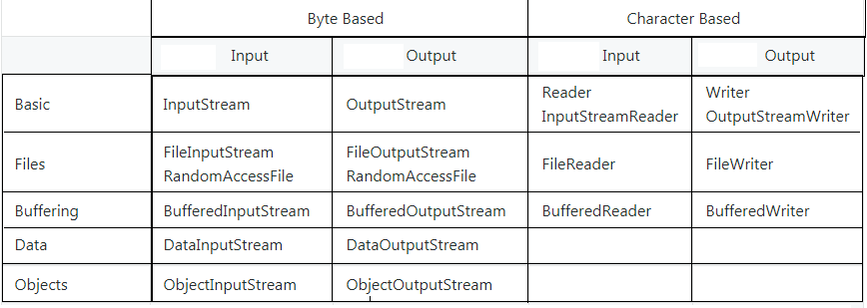
IO Class Overview

Slide 5
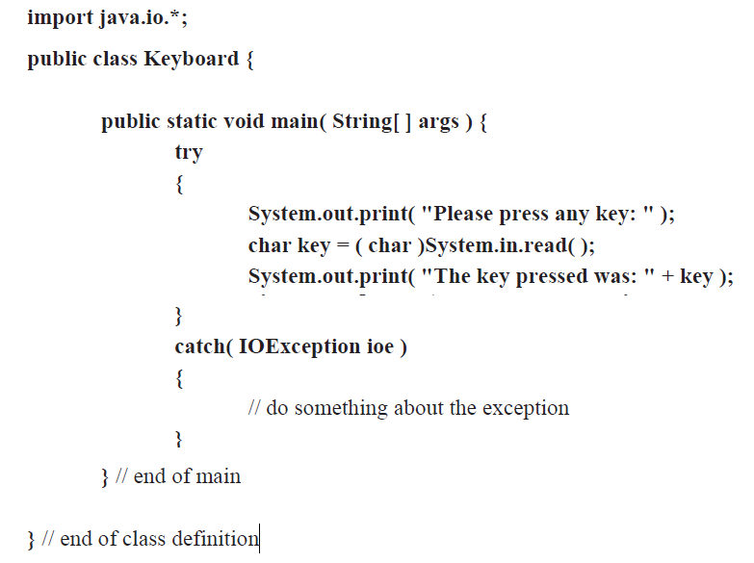

Slide 6
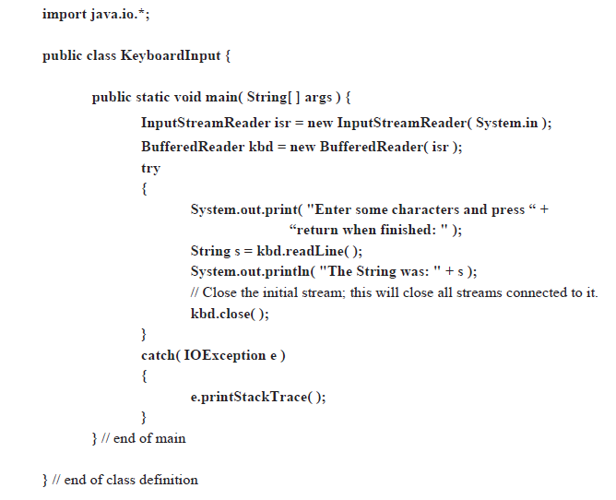

Slide 7
